Slide 1
NETWORKING AND ROUTING PROTOCAL ET 8315
Thursday, May 23, 2024
Mr. Cuthbert John Karawa
Lecture 5
ROUTING LOOPS
College of Information and Communication Technology (CoICT)
Department Of Electronics And Telecommunications Engineering.
1
Notes:
1

Slide 2
Distance Vector Routing Protocols
One way to characterize routing protocols is by the type of routing algorithm they use to build and maintain their routing table.
By doing this, routing protocols can be differentiated as a
Distance vector routing protocol
Link-state routing protocol
Path vector routing protocol.

Slide 3
Distance Vector Protocols
Distance vector routing protocols include RIP, IGRP, and EIGRP.
The following are some key characteristics of these protocols.
Routing Information Protocol (RIP) was originally specified in RFC 1058. It has the following key characteristics:
Hop count is used as the metric for path selection.
If the metric for a network is greater than 15, RIP cannot supply a route to that network.

Slide 4
Distance Vector Protocols
Routing updates are broadcast or multicast every 30 seconds, by default.
Interior Gateway Routing Protocol (IGRP) is a proprietary protocol developed by Cisco. IGRP has the following key design characteristics:
Bandwidth, delay, load, and reliability are used to create a composite metric.
Routing updates are broadcast every 90 seconds, by default.
IGRP is the predecessor of EIGRP and is now obsolete.

Slide 5
Distance Vector Protocols
Enhanced IGRP (EIGRP) is a Cisco-proprietary distance vector routing protocol. EIGRP has these key characteristics:
It can perform unequal-cost load balancing.
It uses Diffusing Update Algorithm (DUAL) to calculate the shortest path.
There are no periodic updates as with RIP and IGRP. Routing updates are sent only when there is a change in the topology.

Slide 6
Distance Vector Protocols
Meaning of Distance Vector
Routes are advertised as vectors of distance and direction. Distance is defined in terms of a metric, and direction is simply the next-hop router or exit interface.
A distance vector router only knows
The direction or interface in which packets should be forwarded.
The distance to the destination network

Slide 7
Distance Vector Protocols
Operation of Distance Vector Routing Protocols
Some distance vector routing protocols call for the router to periodically broadcast the entire routing table to each of its neighbors. This method is inefficient because the updates not only consume network bandwidth but also consume router CPU resources to process the updates.
At the core of the distance vector routing protocol is the algorithm used to calculate the best paths and then send that information to the neighbors.
Neighbors are routers that share a link and are configured to use the same routing protocol.

Slide 8
Routing Protocols Characteristics
Time to convergence
Time to convergence defines how quickly the routers in the network topology share routing information and reach a state of consistent knowledge. The faster the convergence, the more preferable the protocol. Routing loops can occur when inconsistent routing tables are not updated because of slow convergence in a changing network.
Scalability
Scalability defines how large a network can become based on the routing protocol that is deployed.The larger the network is, the more scalable the routing protocol needs to be.

Slide 9
Distance Vector Protocols
Classless (use of VLSM) or classful
Classless routing protocols include the subnet mask in the updates. This feature supports the use of variable-length subnet masking (VLSM) and better route summarization. Classful routing protocols do not include the subnet mask and cannot support VLSM.
Resource usage
Resource usage includes the requirements of a routing protocol, such as memory space, CPU utilization, and link bandwidth utilization. Higher resource requirements necessitate more powerful hardware to support the routing protocol operation in addition to the packet-forwarding processes.

Slide 10
Distance Vector Protocols
Implementation and maintenance
Implementation and maintenance describe the level of knowledge that is required for a network administrator to implement and maintain the network based on the routing protocol deployed.

Slide 11
Network Discovery
Network discovery is part of the process of the routing protocol algorithm that enables routers to first learn about remote networks.
Cold Start
In the first boot ups - the only information that a router has is from its own saved configuration file stored in NVRAM.
After it boots - The router will initially discover its own directly connected networks (discover the network topology)

Slide 12
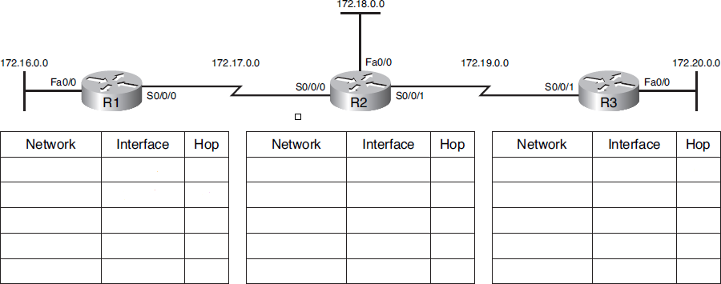
Network Discovery
In Figure below, the routers have booted. However, they have not yet discovered any neighbors.

Slide 13
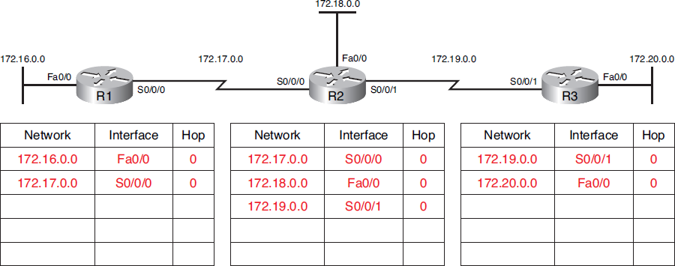
Network Discovery
In Figure below, In the tables below each router, fill in the networks, interfaces, and hop counts that each router has installed in its routing table.

Slide 14
Network Discovery
Initial Exchange of Routing Information
Before the routers start sending each other updates - A routing protocol must be configured on each router.
The first round of updates only includes information about each router’s directly connected networks.

Slide 15
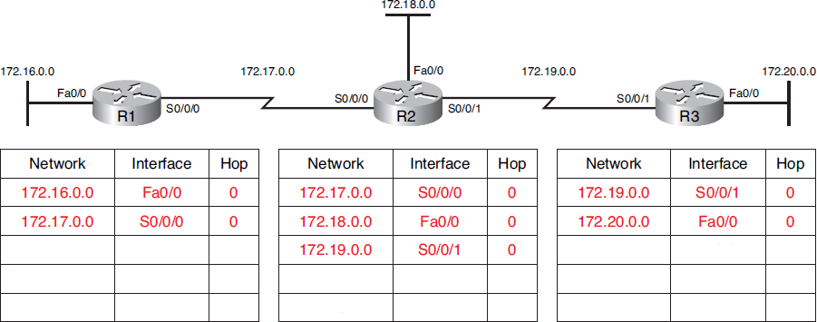
Network Discovery
In Figure below, the routers have completed their initial exchange of routing updates. In the tables below each router, fill in the networks, interfaces, and hop counts that each router now has installed in its routing table.

Slide 16
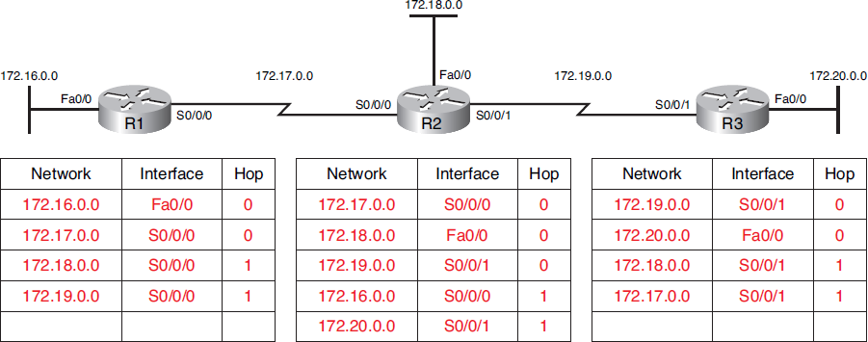
Network Discovery
In Figure below, the routers have completed their initial exchange of routing updates. In the tables below each router, fill in the networks, interfaces, and hop counts that each router now has installed in its routing table.

Slide 17
Network Discovery
At this point in the network discovery process, the routing tables are incomplete. In other words, the network has not yet converged.
R1 does not yet know about 172.20.0.0.
R3 does not yet know about 172.16.0.0.

Slide 18
Network Discovery
Next Update
Continuing the journey toward convergence, the routers exchange the next round of periodic updates.

Slide 19
Network Discovery
In Figure below, the routers have completed their next round of updates. In the tables below each router, fill in the networks, interfaces, and hop counts that each router now has installed in its routing table.

Slide 20
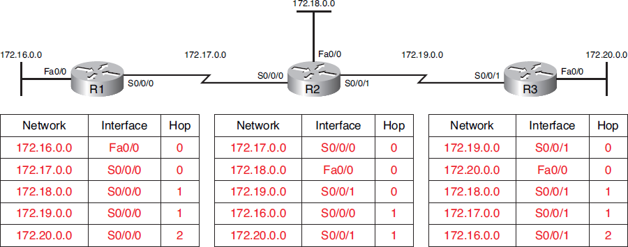
Network Discovery
In Figure below, the routers have completed their next round of updates. In the tables below each router, fill in the networks, interfaces, and hop counts that each router now has installed in its routing table.

Slide 21
Routing Table Maintenance
After the routers have initially learned about remote networks, routing protocols must maintain the routing tables so that they have the most current routing information.
How the routing protocol maintains the routing table depends on the type of routing protocol (distance vector, link-state, or path vector) as well as the routing protocol itself (RIP, EIGRP, and so on).

Slide 22
Distance Vector Table Maintenance
Periodic Updates
The term periodic update refers to the fact that a router sends the complete routing table to its neighbors at a predefined interval, regardless of whether there has been a topology change.
The age of routing information in a routing table is refreshed each time an update is received.
This way, information in the routing table can be maintained when there is a topology change.

Slide 23
Distance Vector Table Maintenance
Periodic Updates
Four ways that changes in the topology might occur.
Failure of a link
Introduction of a new link
Failure of a router
Change of link parameters

Slide 24
Distance Vector Table Maintenance
RIP Timers: RIP has four basic timers:
Update Timer (default 30 seconds) – indicates how often the router will send out a routing table update.
Invalid Timer (default 180 seconds): If an update has not been received to refresh an existing route after 180 seconds the route is marked as invalid by setting the metric to 16. The route is retained in the routing table until the flush timer expires.

Slide 25
Distance Vector Table Maintenance
RIP Timers
Flush timer (default 240 seconds) : Indicates how long a route can remain in a routing table before being flushed, if no new updates are heard about this route. The flush timer runs concurrently with the invalid timer, and thus will flush out a route 60 seconds after it has been marked invalid.

Slide 26
Distance Vector Table Maintenance
RIP Timers
Hold-down timer (default 180 seconds) : This timer stabilizes routing information and helps prevent routing loops during periods when the topology is converging on new information. When a route is marked as unreachable, it must stay in hold-down mode long enough for all routers in the topology to learn about the unreachable network.
RIP timers must be identical on all routers on the RIP network, otherwise massive instability will occur.

Slide 27
Distance Vector Table Maintenance
RIP Timers
Hold-down timer (default 180 seconds) : This timer a route will enter a hold-down state for one of three reasons:
The invalid timer has expired.
An update has been received from another router, marking that route with a metric of 16 (or unreachable).
An update has been received from another router, marking that route with a higher metric than what is currently in the routing table. This is to prevent loops.

Slide 28
Distance Vector Table Maintenance
RIP Timers
What two commands will show timer values?
show ip route
show ip protocols

Slide 29
Distance Vector Table Maintenance
EIGRP Updates
Unlike other distance vector routing protocols, EIGRP does not send periodic updates.
EIGRP uses the following types of updates:
Nonperiodic: They are not sent out on a regular basis.
Partial: These updates are sent only when there is a change in topology that influences routing information.
Bounded: The propagation of partial updates is automatically bounded so that only those routers that need the information are updated.

Slide 30
Distance Vector Table Maintenance
Triggered Updates
To speed the convergence when there is a topology change, RIP uses triggered updates.
A triggered update is a routing table update that is sent immediately in response to a routing change. Triggered updates do not wait for update timers to expire.
Triggered updates are sent when
An interface changes state (up or down)
A route has entered (or exited) the “unreachable” state
A route is installed in the routing table

Slide 31
Distance Vector Table Maintenance
Random Jitter
Over time, the update interval across the routers in the topology can become synchronized, which can cause problems. As more routers’ timers become synchronized, more collisions of updates and more delays occur in the network.
To prevent the synchronization of updates between routers, the Cisco IOS uses a random variable, called RIP_JITTER, that varies the update interval randomly in a range from 25 to 30 seconds for the default 30-second interval.

Slide 32
Routing Loops
Routing loops can cause a severe impact on network performance.
A routing loop is a condition in which a packet is continuously transmitted within a series of routers without ever reaching its intended destination network.
A routing loop can occur when two or more routers have routing information that incorrectly indicates that a valid path to an unreachable destination exists.

Slide 33
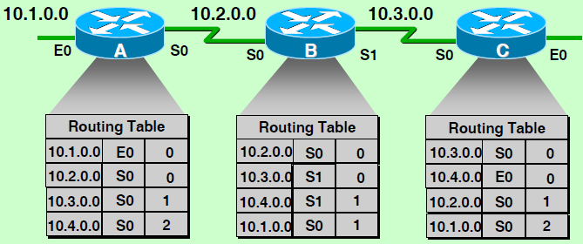
Maintaining Routing Information Problem—Routing Loops
Each node maintains the distance from itself to each possible destination network

Slide 34
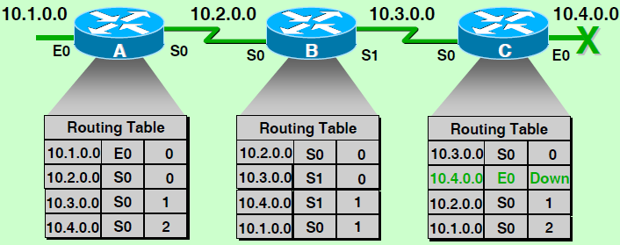
Maintaining Routing Information Problem—Routing Loops
Slow convergence produces inconsistent routing

Slide 35
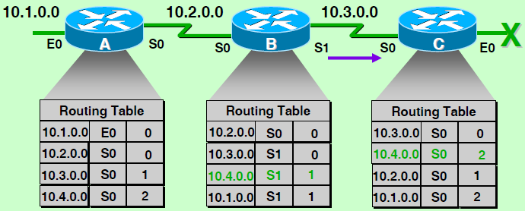
Maintaining Routing Information Problem—Routing Loops
Router C concludes that the best path to network 10.4.0.0 is through Router B

Slide 36
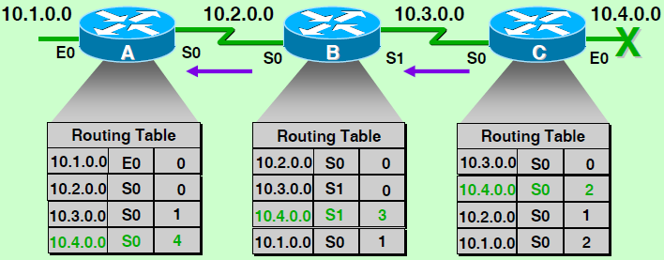
Maintaining Routing Information Problem—Routing Loops
Router A updates its table to reflect the new but erroneous hop count

Slide 37
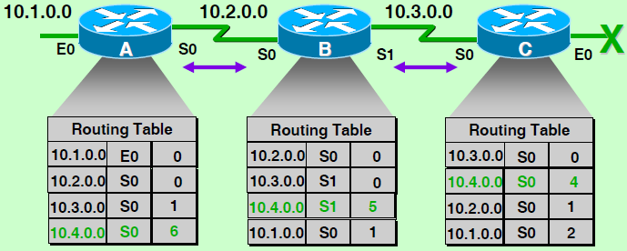
Symptom: Counting to Infinity
Packets for network 10.4.0.0 bounce between routers A, B, and C
Hop count for network 10.4.0.0 counts to infinity

Slide 38
Routing Loops
Four ways that a routing loop can happen.
Incorrectly configured static routes
Incorrectly configured route redistribution (redistribution is a process of handing the routing information from one routing protocol to another routing protocol)
Inconsistent routing tables not being updated because of slow convergence in a changing network
Incorrectly configured or installed discard routes

Slide 39
Routing Loops
Implications of Routing Loops
A routing loop can have a devastating effect on a network, resulting in degraded network performance or even network downtime.

Slide 40
Routing Loops
Five effects that routing loops can have on a network.
Link bandwidth will be used for traffic looping back and forth between the routers in a loop.
A router’s CPU will be strained because of looping packets.
A router’s CPU will be burdened with useless packet forwarding that will negatively impact the convergence of the network.
Routing updates might get lost or might not be processed in a timely manner. These conditions would introduce additional routing loops, making the situation even worse.
Packets can get lost in “black holes.”

Slide 41
Routing Loop Prevention Mechanisms
There are five mechanisms available to eliminate routing loops:
Defining a maximum metric to prevent a count to infinity
Hold-down timers
Split horizon
Route poisoning or poison reverse
Triggered updates

Slide 42
Count to Infinity
Count to infinity is a condition that exists when inaccurate routing updates increase the metric value to “infinity” for a network that is no longer reachable. Each protocol defines infinity at a different value.
To eventually stop the incrementing of the metric, “infinity” is defined by setting a maximum metric value.
What is the maximum or infinity value for RIP? 16 hops

Slide 43
Hold-down Timers
Hold-down timers are used to prevent regular update messages from inappropriately reinstating a route that might have gone bad.
Hold-down timers instruct routers to hold any changes that might affect routes for a specified period of time. If a route is identified as down or possibly down, any other information for that route containing the same status, or worse, is ignored for a predetermined amount of time (the hold-down period).
This means that routers will leave a route marked as unreachable in that state for a period of time that is long enough for updates to propagate the routing tables with the most current information.

Slide 44
Split horizon
The split horizon rule says that a router should not advertise a network through the interface from which the update came.

Slide 45
Route Poisoning
Route poisoning is marking a route as unreachable in a routing update that is sent to other routers. Unreachable is interpreted as a metric that is set to the maximum.
Route poisoning speeds the convergence process because the information about a downed network spreads more quickly than waiting for the hop count to reach “infinity.”

Slide 46
Split Horizon with Poison Reverse
The rule for split horizon with poison reverse states that when sending updates out a specific interface, designate any networks that were learned on that interface as unreachable.
In other words, when receiving a route poisoning from a neighbor, the router immediately sends back a poison reverse. This prevents the originating router from being susceptible to incorrect updates about the downed network.

Slide 47
Triggered Updates
To speed the convergence when there is a topology change, RIP uses triggered updates.
A triggered update is a routing table update that is sent immediately in response to a routing change. Triggered updates do not wait for update timers to expire.
Triggered updates are sent when
An interface changes state (up or down)
A route has entered (or exited) the “unreachable” state
A route is installed in the routing table

Slide 48
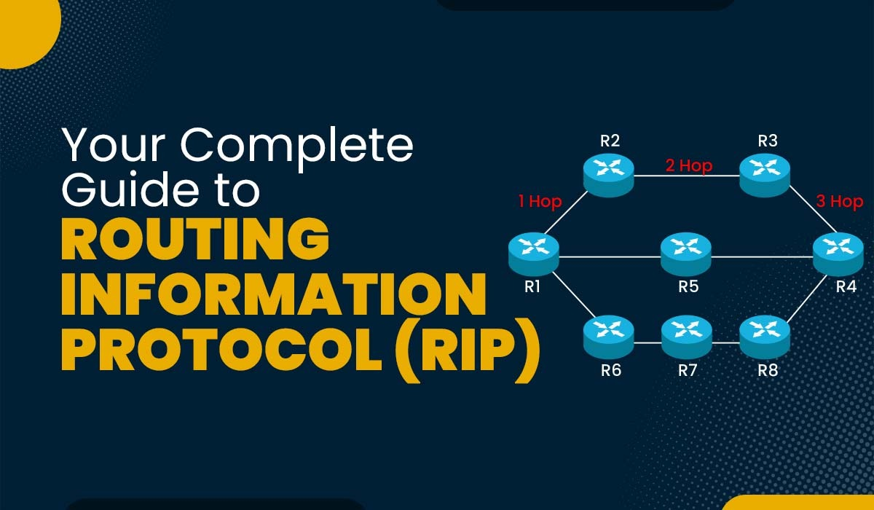
RIP:
Routing Information Protocol

Slide 49
Routing Information Protocol (RIP)
RIP: Routing Information Protocol
Based on distance vector routing
Designed for use on smaller networks.
RIP was one of the first true Distance Vector routing protocols, and is supported on a wide variety of systems.

Slide 50
Routing Information Protocol (RIP)
RIP adheres to the following Distance Vector characteristics:
Sends out periodic routing updates (every 30 seconds)
Sends out the full routing table every periodic update.
Uses a form of distance as its metric (in this case, hop count)
Uses the Bellman-Ford Distance Vector algorithm to determine the best “path” to a particular destination

Slide 51
Routing Information Protocol (RIP)
Other characteristics of RIP include:
RIP supports IP and IPX (Internetwork Packet Exchange) routing.
RIP utilizes UDP port 520.
RIP routes have an administrative distance of 120.
RIP has a maximum hop count of 15 hops.
Any network that is 16 hops away or more is considered unreachable to RIP, thus the maximum diameter of the network is 15 hops. A metric of 16 hops in RIP is considered a poison route or infinity metric.

Slide 52
Routing Information Protocol (RIP)
Each router periodically shares its knowledge about the entire internet with its neighbors
Sharing knowledge about the entire AS
At the start, a router’s knowledge may be sparse
But, how much it knows is unimportant, it sends whatever it has
Sharing only with neighbors
Sends its knowledge only to neighbors
Sharing at regular intervals

Slide 53
RIP Updating Information
Routing table is updated on receipt of a RIP response message
Receipt: a response RIP message
Add one hop to the hop count for each advertised destination
Repeat the following steps for each advertised destination

Slide 54
RIP Updating Information
If (destination not in the routing table)
Add the advertised information to the table
Else
If (next-hop field is the same)
Replace retry in the table with the advertised one
Else
If (advertised hop count smaller than one in the table)
Replace entry in the routing table
Return

Slide 55
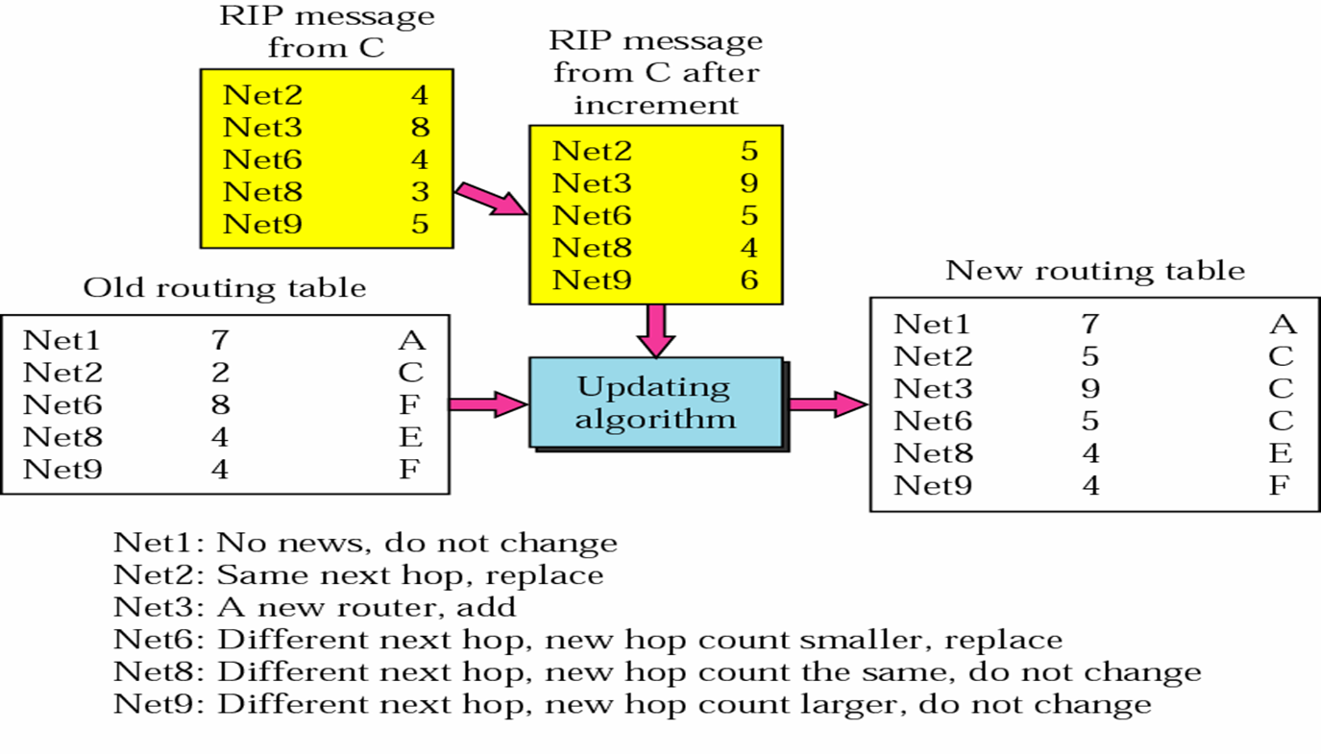
RIP Updating Information

Slide 56
Initializing the Routing Table
When a router is added to a network
It initializes a routing table for itself using its configuration file
The table contains only the directly attached(connected) networks and the hop count (= 1)
Each routing table is updated upon receipt of RIP message
Using the RIP updating message algorithm shown on previous slide.

Slide 57
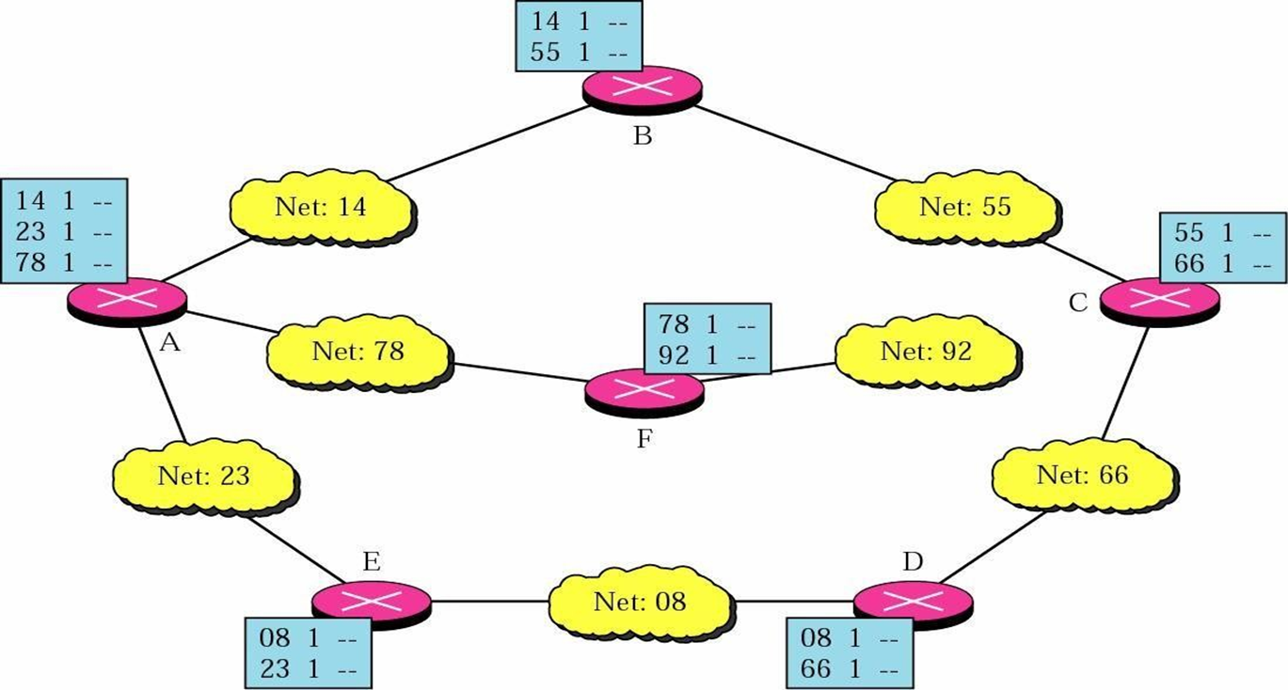
Initial Routing Tables in a Small Autonomous System

Slide 58
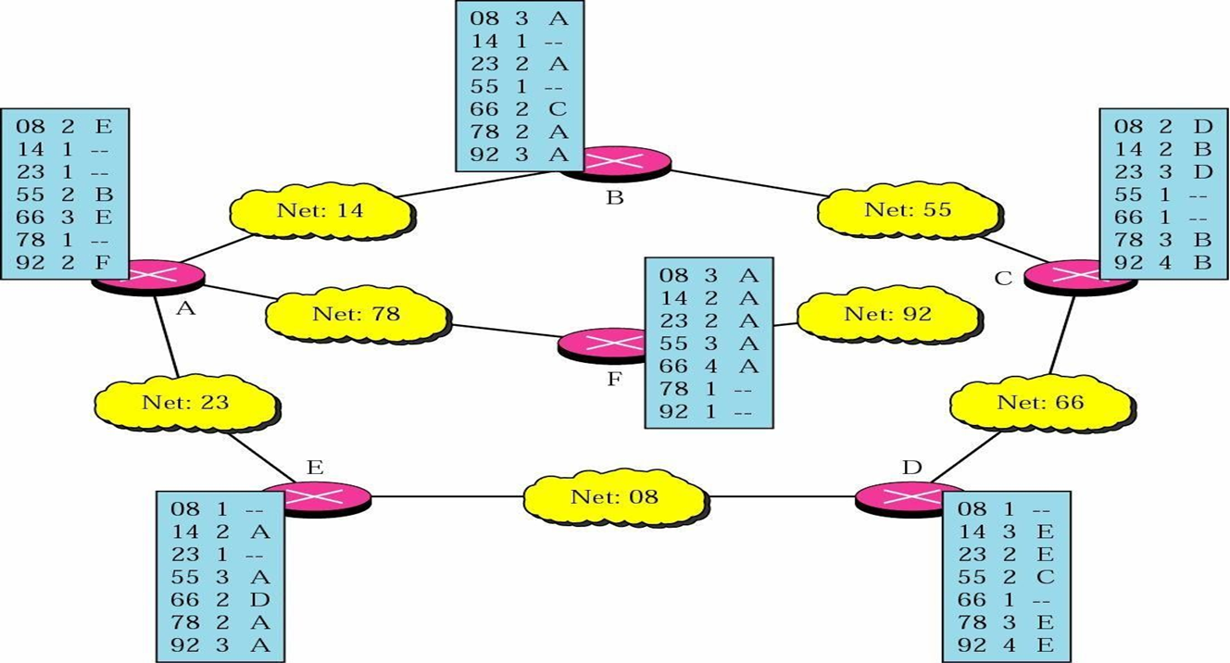
Final Routing Tables for the Previous Figure

Slide 59
RIP Message
RIP uses two type of messages
Request and response
Request
Sent by a router that has just come up or has some time-out entries
Can ask specific entries or all entries

Slide 60
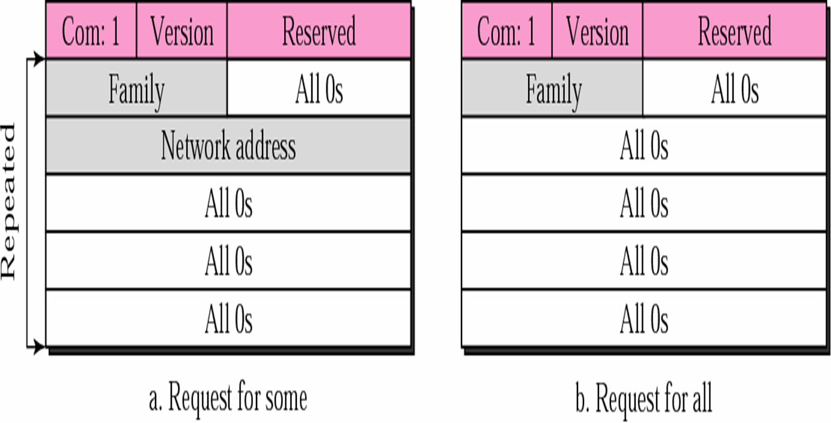
RIP Message

Slide 61
RIP Message
Response: solicited or unsolicited
A solicited response: sent only in answer to a request,
Contain information about the destination specified in the corresponding request
An unsolicited response: sent periodically
Every 30s,
Contains information about the entire routing table,
Also called update packet

Slide 62
Routing Information Protocol (RIP)
Administrative distance (AD) is the trustworthiness (or preference) of the route source. RIP has a default AD of 120.
What two command outputs display the AD value?
show ip route
show ip protocols

Slide 63
Routing Information Protocol (RIP)
It's common to see that your router has multiple paths for the same network, with the same metric.
What does RIP do in this case? If the metric is the same, then it will use all possible paths and load balance over them. This is called equal cost load balancing.
If multiple paths exist to a particular destination, RIP will load balance between those paths (by default, up to 4) only if the metric (hop count) is equal.
RIP uses a round-robin system of load balancing between equal metric routes, which can lead to pinhole congestion.

Slide 64
Routing Information Protocol (RIP)
For example, two paths might exist to a particular destination, one going through a 9600 baud link, the other via a T1. If the metric (hopcount) is equal, RIP will load- balance, sending an equal amount of traffic down the 9600 baud link and the T1. This will (obviously) cause the slower link to become congested.

Slide 65
RIP Versions
RIP has two versions:
Version 1 (RIPv1) -RFC 1058
Version 2 (RIPv2) -RFC 2543

Slide 66
RIP Versions 1 (RIPv1)
RIPv1 (RFC 1058) is classful, and thus does not include the subnet mask with its routing table updates. Because of this, RIPv1 does not support Variable Length Subnet Masks (VLSMs).
When using RIPv1, networks must be contiguous, and subnets of a major network must be configured with identical subnet masks. Otherwise, route table inconsistencies (or worse) will occur.
RIPv1 sends updates as broadcasts to address 255.255.255.255.

Slide 67
RIP Versions 2 (RIPv2)
RIPv2 (RFC 2543) is classless, and thus does include the subnet mask with its routing table updates. RIPv2 fully supports VLSMs, allowing discontiguous networks and varying subnet masks to exist.
Other enhancements offered by RIPv2 include:
Routing updates are sent via multicast, using address
224.0.0.9
Encrypted authentication can be configured between
RIPv2 routers
Route tagging is supported.

Slide 68
RIP Versions 2 (RIPv2)
RIPv2 can interoperate with RIPv1. By default:
RIPv1 routers will sent only Version 1 packets
RIPv1 routers will receive both Version 1 and 2 updates.
RIPv2 routers will both send and receive only Version 2 updates
We can control the version of RIP a particular interface will “send” or “receive.”
Unless RIPv2 is manually specified, a Cisco will default to RIPv1 when configuring RIP.

Slide 69

RIPv1 Basic Configuration
To enter router configuration mode for RIP, enter router rip at the global configuration prompt.
R1(config)# router rip
R1(config-router)# What is the router prompt at this point?
What command would you enter to remove the RIP routing process
from a device?
R1(config)# no router rip
This command stops the RIP process and erases all existing RIP configurations.

Slide 70
RIPv1 Basic Configuration
To enable RIP routing for a network, use the network command in router configuration mode and enter the classful network address for each directly connected network
R1(config-router)# network ip address
What two functions does this command achieve?
Enables RIP on all interfaces that belong to a specific network. Associated interfaces will now both send and receive RIP updates.
Advertises the specified network in RIP routing updates sent to other routers every 30 seconds..

Slide 71
RIPv1 Basic Configuration
Routing protocol configuration occurs in Global Configuration mode.
On Router A, to configure RIP, we would type:
RouterA(config)# router rip
RouterA(config-router)# network 172.16.0.0
RouterA(config-router)# network 172.17.0.0
The first command, router rip, enables the RIP process.

Slide 72
RIPv1 Basic Configuration
The network statements tell RIP which networks you wish to advertise to other RIP routers. We simply list the networks that are directly connected to our router. Notice that we specify the networks at their classful boundaries, and we do not specify a subnet mask.
To configure Router B:
RouterB(config)# router rip
RouterB(config-router)# network 172.17.0.0
RouterB(config-router)# network 172.18.0.0

Slide 73
RIPv1 Basic Configuration
The routing table on Router A will look like:
RouterA# show ip route
Examining the routing table is an easy way to see whether the routing protocol and commands have been properly configured.

Slide 74
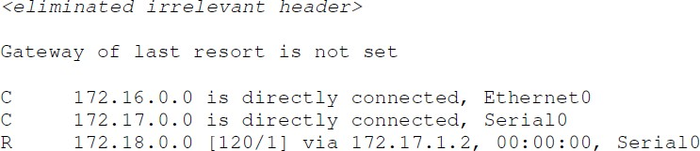
RIPv1 Basic Configuration
The routing table on Router A will look like:
RouterA# show ip route

Slide 75

RIPv1 Basic Configuration
Now focus on one RIP route learned by Router A and interpret the output shown in the routing table:
R 172.18.0.0 [120/0] via 172.17.1.2, 00:00:00, Serial0
R: identifies the source of the route as RIP
172.18.0.0: indicates the address of the remote network
[120/1]: indicates the administrative distance (120) and the metric (1 hop)
Via 172.17.1.2 specifies the address of the next-hop routerB to send traffic to for the remote network.

Slide 76
RIPv1 Basic Configuration
Now focus on one RIP route learned by Router A and interpret the output shown in the routing table:
R 172.18.0.0 [120/0] via 172.17.1.2, 00:00:00, Serial0
00:00:00: specifies the amount of time the route was updated (here, 0 seconds) another updates is due in 30 seconds.
Serial 0: specifies the local interface through which the remote network can be reached.

Slide 77
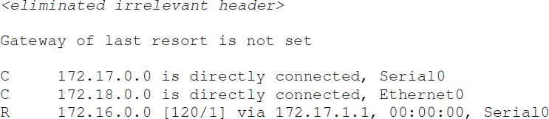
RIPv1 Basic Configuration
The routing table on Router B will look like:
RouterB# show ip route

Slide 78
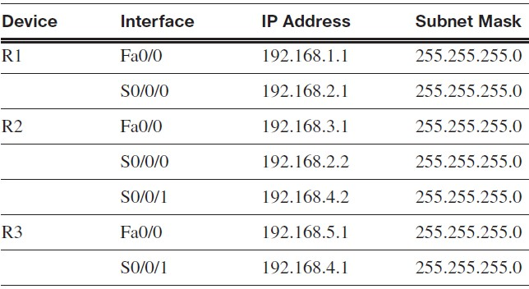
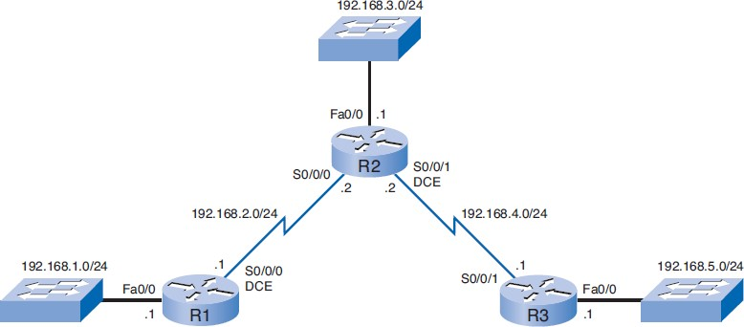
RIPv1 Basic Configuration

Slide 79
RIPv1 Basic Configuration
R1(config)# router rip
R1(config-router)# network 192.168.1.0
R1(config-router)# network 192.168.2.0

Slide 80
RIPv1 Basic Configuration
R2(config)# router rip
R2(config-router)# network 192.168.2.0
R2(config-router)# network 192.168.3.0
R2(config-router)# network 192.168.4.0

Slide 81
RIPv1 Basic Configuration
R3(config)# router rip
R3(config-router)# network 192.168.4.0
R3(config-router)# network 192.168.5.0

Slide 82
Passive Interfaces
Some routers can have interfaces that do not connect to another router; therefore, there is no reason to send routing updates out that interface. You can use the passive-interface command with RIP to configure an interface not to send those updates.
R1, R2, and R3 are currently sending out RIP updates on all interfaces—including LAN interfaces out which there is no RIP neighbor.

Slide 83
Passive Interfaces
Three ways these unnecessary updates negatively impact the LAN environment.
Bandwidth is wasted transporting unnecessary updates. Because RIP updates are broadcast, switches will forward the updates out all ports.
All devices on the LAN must process the update up to the transport layers, where the receiving device will discard the update.
Advertising updates on a broadcast network is a security risk. RIP updates can be intercepted with packet-sniffing software. Routing updates can be modified and sent back to the router, corrupting the routing table with false metrics that misdirect traffic.

Slide 84
Passive Interfaces
What command, including the router prompt, do you use to stop unnecessary updates out an interface?
Router(config-router)# passive-interface interfaceNumber

Slide 85
Disabling Updates with the passive-interface Command
R2(config)# router rip
R2(config-router)# passive-interface FastEthernet 0/0
R2(config-router)# end
R2# show ip protocols

Slide 86
Home Work
What is the main disadvantage of using RIP?
Differences between RIPv1 and RIPv2.
How Routing Information Protocol works.

Slide 87

87
Notes:
87

Slide 88
THANK YOU
Notes:
88

